Slide 1
DFC40243
SYSTEM ANALYSIS & DESIGN
TOPIC 4 SYSTEM DESIGN

Slide 2
Course Learning Outcome
CLO 1: Implement the appropriate model, tools and techniques concept of System Analysis and Design for developing project
CLO 2: Prepare the appropriate key deliverable’s of each phase in System Development Life Cycle (SDLC) activities
CLO 3: Perform a good personal skills with peers in proposing a project development

Slide 3
CHAPTER 4: SYSTEM DESIGN
4.1 Understand user interface design
4.2 Apply input and output design
1. Explain input design and technology issues
2. List the objectives of input design
3. Discuss guidelines for data entry screen design
4. Differentiate data capture and data entry
5. Explain input and data entry methods
6. Explain input masks and validation rules to reduce input errors:
7. Design effective source documents and input controls
8. Explain various output types and the technologies:
9. Identify different type of reports:
10. Explain the design report principles
11. Design output interface by applying the appropriate techniques
12. Describe output and input controls and security

Slide 4
4.2 APPLY INPUT AND OUTPUT DESIGN
Notes:
Chapter 7 – Development strategies

Slide 5
1. Input Design
Input design features will ensure the reliability of the systems and produce results from accurate data, or thus can be result in the production of erroneous information.
The input design also determines whenever the user can interact efficiently with this system.
Input design consists of developing specifications and procedures for data preparation, the steps necessary to put transaction data into a usable from for processing and data entry, the activity of data into the computer processing.

Slide 6
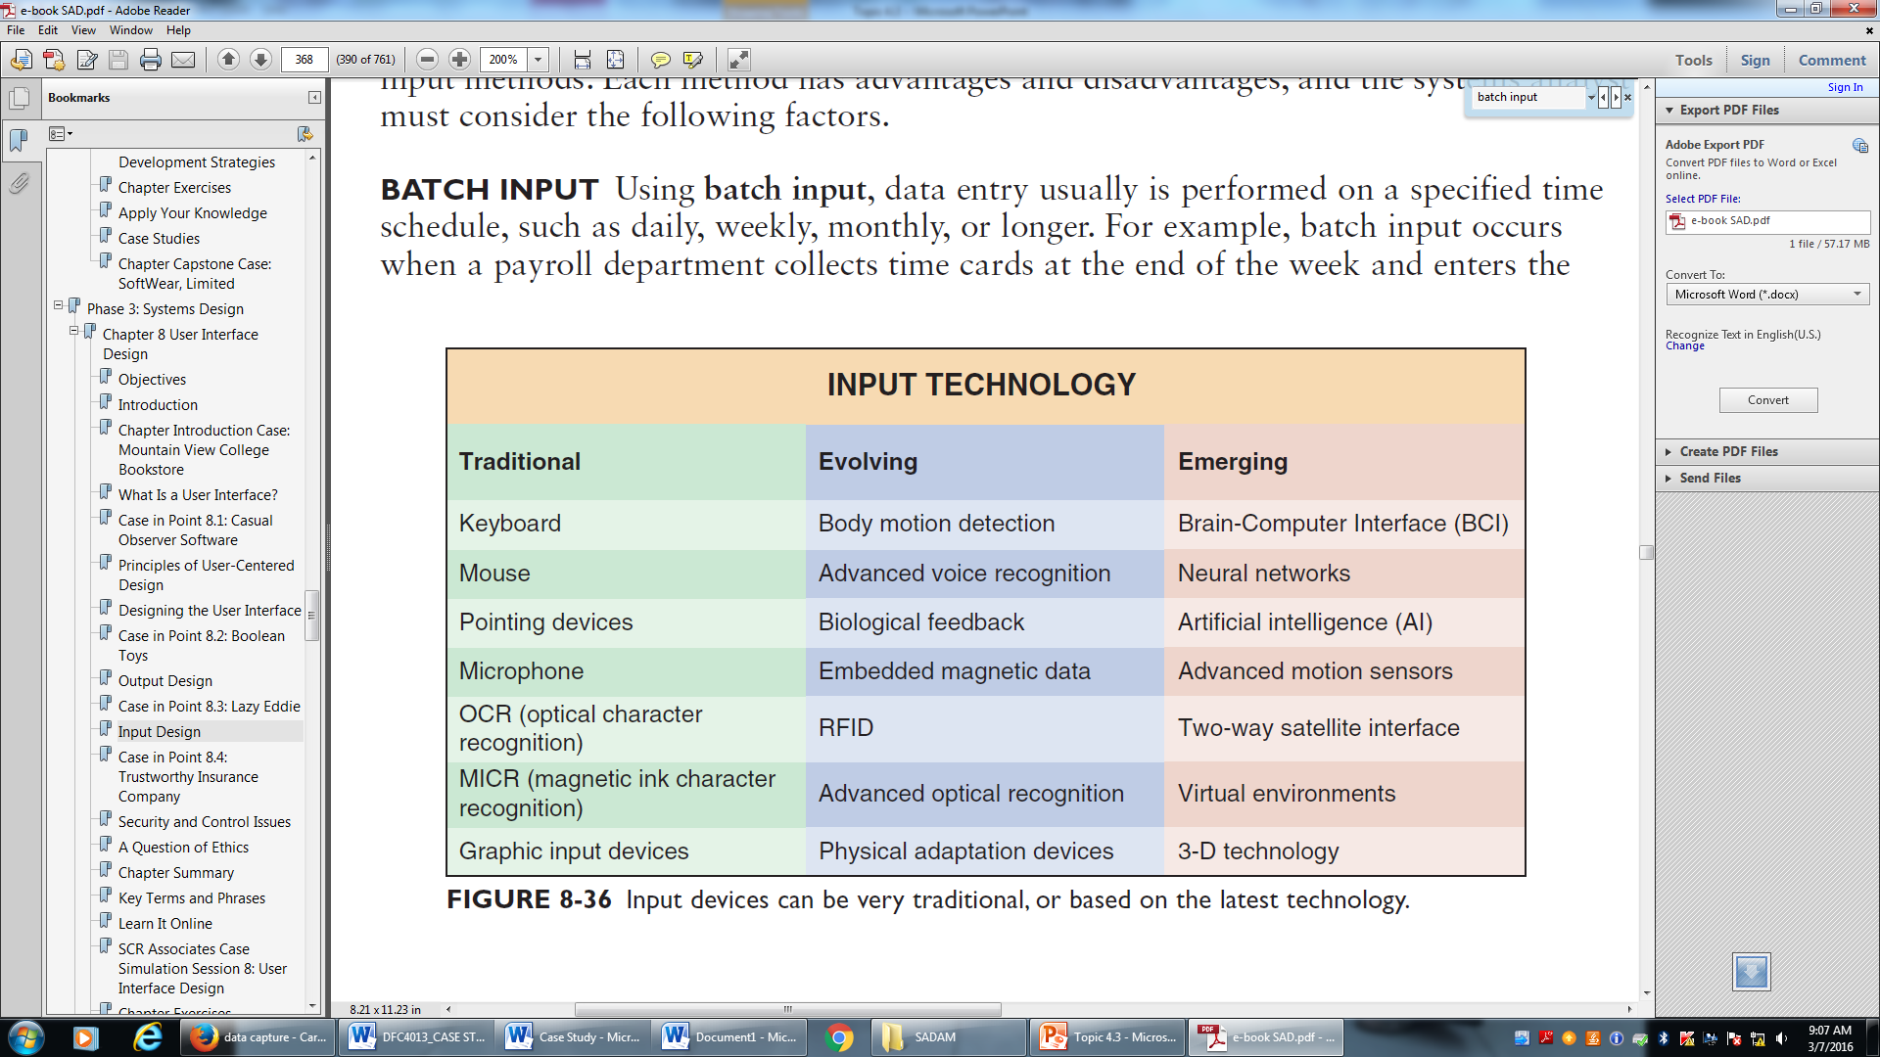
1. Input design & Technology issues
Input technology has changed dramatically in recent years. In addition to traditional devices and methods, there has been a rapid expansion of new hardware and ways to capture and enter data into a system.
Input devices can be very traditional, or based on the latest technology.

Slide 7
2. Objectives of Input Design
Controlling the amount of input
Avoiding delay
Avoiding error in data
Avoiding extra steps
Keeping the process simple
to ensure the quality, accuracy, and timeliness of input data.

Slide 8
3. Data entry
Data entry is the process of manually entering data into the information system, usually in the form of keystrokes, mouse clicks, touch screens, or spoken words.
Guidelines:
Restrict user access to screen locations where data is entered. After the operator enters a Customer ID, the insertion point should move automatically to the entry location for the next field.

Slide 9
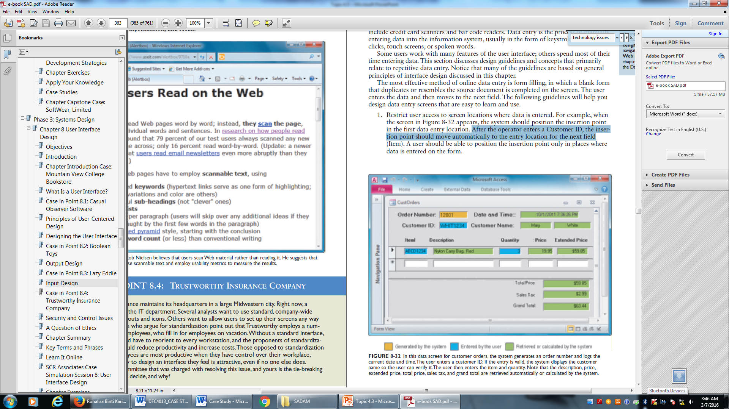
3. Guideline for data entry screen design
Restrict user access to screen locations where data is entered. After the operator enters a Customer ID, the insertion point should move automatically to the entry location for the next field.

Slide 10
3. Guideline for data entry screen design
Provide a descriptive caption for every field, and show the user where to enter the data and the required or maximum field size. Using white boxes show the location and length of each field.
Display a sample format if a user must enter values in a field in a specific format. For example, provide an on-screen instruction to let users know that the date format is MMDDYY, and provide an example if the user must enter separators, such as slashes.
Require an ending keystroke for every field. Pressing the enter key or the tab key should signify the end of a field entry. Avoid a design that moves automatically to the next item when the field is full.

Slide 11
3. Guideline for data entry screen design
Do not require users to type leading zeroes for numeric fields. For example, if a three-digit project number is 045, the operator should be able to type 45 instead of 045 before pressing the enter key.
Do not require users to type trailing zeroes for numbers that include decimals. For example, when a user types a value of 98, the system should interpret the value as 98.00 if the field has been formatted to include numbers with two decimal places.
Display default values so operators can press the enter key to accept the suggested value.
Use a default value when a field value will be constant for successive records or throughout the data entry session.

Slide 12
3. Guideline for data entry screen design
Display a list of acceptable values for fields, and provide meaningful error messages if the user enters an unacceptable value.
Provide a way to leave the data entry screen at any time without entering the current record.
Provide users with an opportunity to confirm the accuracy of input data before entering it by displaying a message such as, Add this record? (Y/N).
Design the screen form layout to match the layout of the source document. If the source document fields start at the top of the form and run down in a column, the input screen should use the same design.
Allow users to add, change, delete, and view records.
Provide a method to allow users to search for specific information.

Slide 13

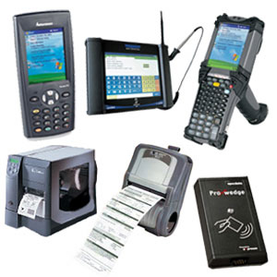
4. Data Capture vs Data Entry
Data capture uses an automated or manually operated device to identify source data and convert it into computer-readable form.
Examples of data capture devices include credit card scanners and bar code readers.
Data entry is the process of manually entering data into the information system, usually in the form of keystrokes, mouse
clicks, touch screens, or spoken words.

Slide 14
4. Input and Data Entry methods
BATCH INPUT
data entry usually is performed on a specified time
schedule, such as daily, weekly, monthly, or longer. For example, batch input occurs when a payroll department collects time cards at the end of the week and enters the data as a batch.
ONLINE INPUT
involved keying in directly into the system and instantly been processed into information.
The user can obtain current/updated information at any given point of time.
Example : Automatic teller machines (ATMs) that read data strips on bank cards.
Devices : RFID tags or magnetic data strips

Slide 15
6. Input Mask
Use input masks, which are templates or patterns that restrict data entry and prevent errors.
Microsoft Access 2010 provides standard input masks for fields such as dates, telephone numbers, postal codes, and Social Security numbers.
Notes:
m/s 367

Slide 16
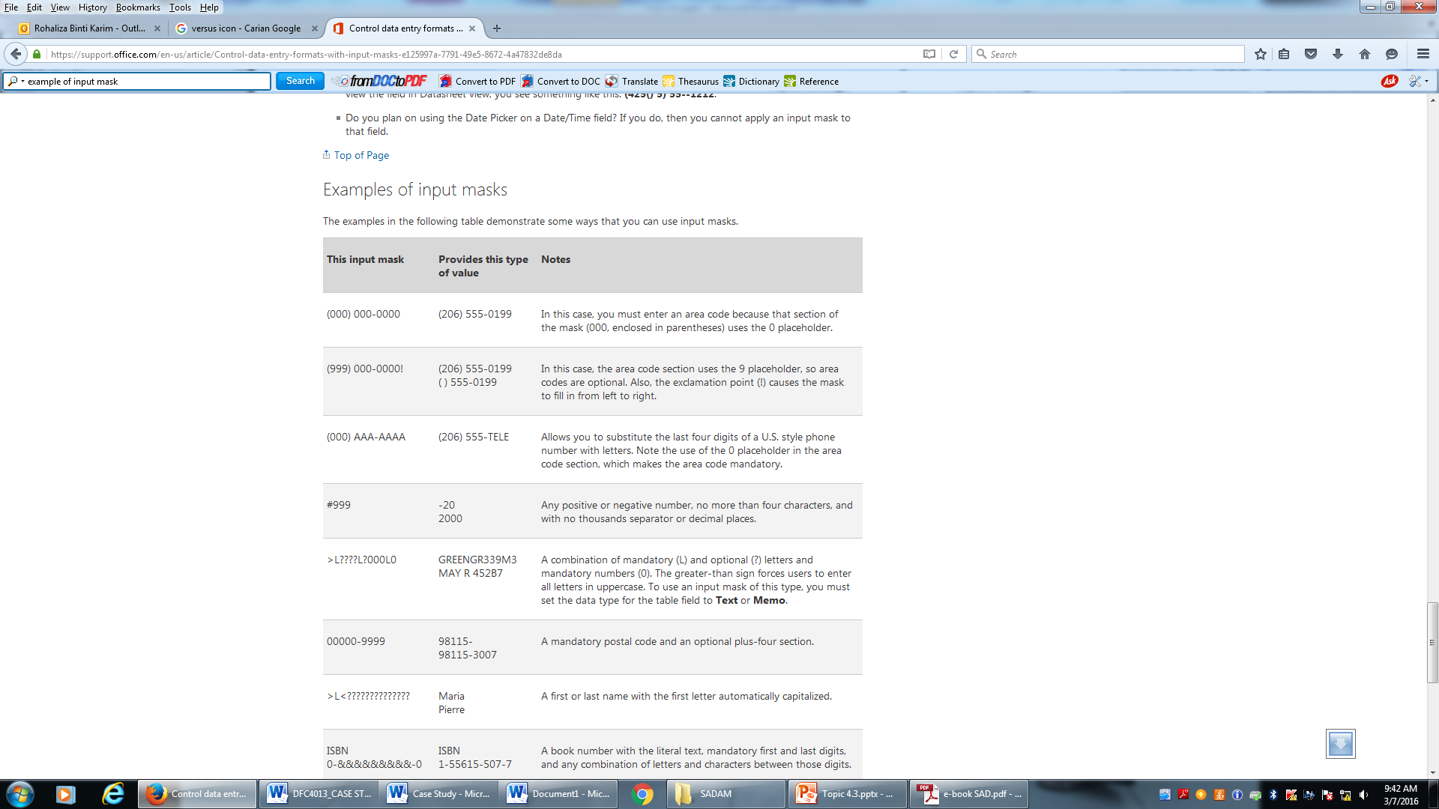
6. Input Mask
Notes:
m/s 367

Slide 17
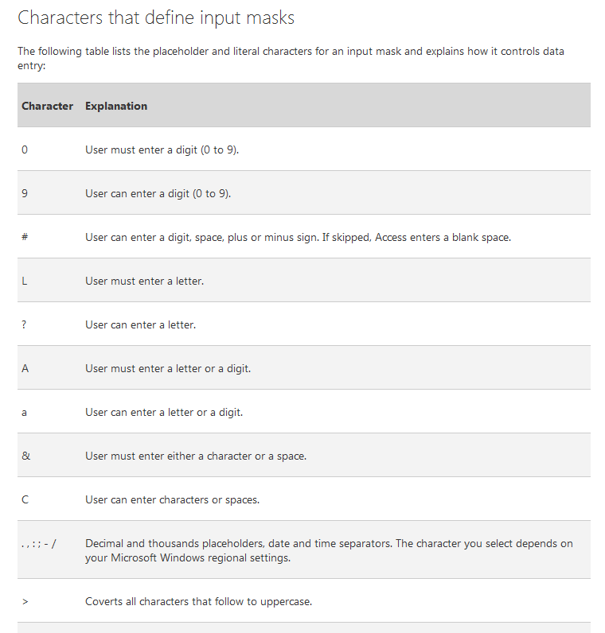
6. Input Mask
Notes:
m/s 367

Slide 18
6. Validation Rules
Reducing the number of input errors improves data quality.
One way to reduce input errors is to eliminate unnecessary data entry.
A data validation rule improves input quality by testing the data and rejecting any entry that fails to meet specified conditions.
For example, a user cannot misspell a customer name if it is not entered, or is entered automatically based on the user entering the customer ID.

Slide 19
6. Input masks and validation rules to reduce input errors
1. Sequence Check
2. Existence Check
3. Data type Check
4. Range Check
5. Reasonableness Check
6. Validity Check
7. Combination Check
8. Batch Control

Slide 20
1. Sequence Check
A sequence check is used when the data must be in some predetermined sequence.
If the user must enter work orders in numerical sequence, for example, then an out-of-sequence order number indicates an error, or if the user must enter transactions chronologically, then a transaction with an out-of-sequence date indicates an error.

Slide 21
2. Existence Check
An existence check is used for mandatory data items.
For example, if an employee record requires a Social Security number, an existence check would not allow the user to save the record until he or she enters a suitable value in the Social Security number field.

Slide 22
3. Data type check
A data type check tests to ensure that a data item fits the required data type.
For example, a numeric field must have only numbers or numeric symbols, and an alphabetic field can contain only the characters A through Z (or a through z).

Slide 23
4. Range Check
A range check tests data items to verify that they fall between a specified minimum and maximum value.
The daily hours worked by an employee, for example, must fall within the range of 0 to 24.
When the validation check involves a minimum or a maximum value, but not both, it is called a limit check.
Checking that a payment amount is greater than zero, but not specifying a maximum value, is an example of a limit check.

Slide 24
5. Reasonableness Check
A reasonableness check identifies values that are questionable, but not necessarily wrong.
For example, input payment values of RM0.05 and RM5,000,000.00 both pass a simple limit check for a payment value greater than zero, and yet both values could be errors.
Similarly, a daily hours worked value of 24 passes a 0 to 24 range check; however, the value seems unusual, and the system should verify it using a reasonableness check.

Slide 25
6. Validity Check
A validity check is used for data items that must have certain values.
For example, if an inventory system has 20 valid item classes, then any input item that does not match one of the valid classes will fail the check.
Verifying that a customer number on an order matches a customer number in the customer file is another type of validity check.
Another validity check might verify that a new customer number does not match a number already stored in the customer master file.

Slide 26
7. Combination Check
A combination check is performed on two or more fields to ensure that they are consistent or reasonable when considered together.
For example, if an order input for 30 units of a particular item has an input discount rate applicable only for purchases of 100 or more units, then the combination is invalid; either the input order quantity or the input discount rate is incorrect.

Slide 27
8. Batch Control
Batch controls are totals used to verify batch input. Batch controls might check data items such as record counts and numeric field totals.
For example, before entering a batch of orders, a user might calculate the total number of orders and the sum of all the order quantities.
When the batch of orders is entered, the order system also calculates the same two totals. If the system totals do not match the input totals, then a data entry error has occurred.

Slide 28
7. Input Controls
Input control includes the necessary measures to ensure that input data is correct, complete, and secure.
You must focus on input control during every phase of input design, starting with source documents that promote data accuracy and quality.

Slide 29
8. Output Types and Technologies
Internet-based Information Delivery
To support the explosive growth in e-commerce, Web designers must provide user-friendly screen interfaces that display output and accept input from customers.
Email : Employees send and receive e-mail on local or wide area networks, including the Internet. Employees use e-mail to exchange documents, data, and schedules and to share business-related information they need to perform their jobs.
Blogs : Blogs are useful for posting news, reviewing current events, and promoting products.
Instant Messaging : This popular form of communication is another way for individuals and companies to communicate effectively over the Internet.
Wireless Devices : Messages and data can be transmitted to a wide array of mobile devices, including PDAs, handheld computers, smart cell phones, and similar wireless products that combine portable computing power, multimedia capability, and Internet access.

Slide 30
8. Output Types and Technologies
Computer Output To Digital Media
This process is used when many paper documents must be scanned, stored in digital format, and retrieved quickly.
For example, if an insurance company stores thousands of paper application forms, special software can treat the documents as data and extract information from a particular column or area on the form.
Digital storage media can include magnetic tape, CDs, DVDs, and high-density laser disks.

Slide 31
8. Output Types and Technologies
Specialized form of output
An incredibly diverse marketplace requires many forms of specialized output and devices such as these:
Portable, Web-connected devices that can run applications, handle multimedia output, and provide powerful, multipurpose communication for users.
Retail point-of-sale terminals that handle computer-based credit card transactions, print receipts, and update inventory records
Automatic teller machines (ATMs) that can process bank transactions and print deposit and withdrawal slips.
Special-purpose printers that can produce labels, employee ID cards, driver’s licenses, gasoline pump receipts, and, in some states, lottery tickets.
Plotters that can produce high-quality images such as blueprints, maps, and electronic circuit diagrams.
Electronic detection of data embedded in credit cards, bank cards, and employee identification cards.

Slide 32
9. Report Design
Printed report are portable, convenient, and even necessary in some situations.
Many users find it handy to view screen output, then print the information they need for a discussion or business meeting.
reports must be easy to read and well organized.
When designing reports, the essential goal is to match the report to the user’s specific information needs.

Slide 33
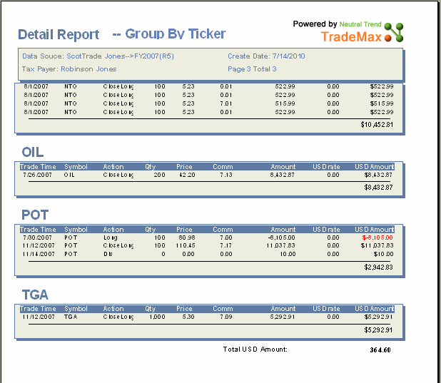
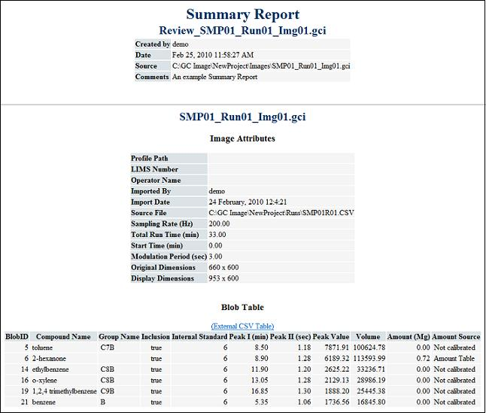
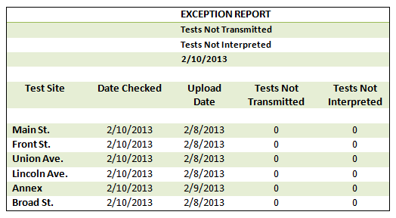
9. Types of report
Summary Reports
Exception Reports
Detail Report

Slide 34
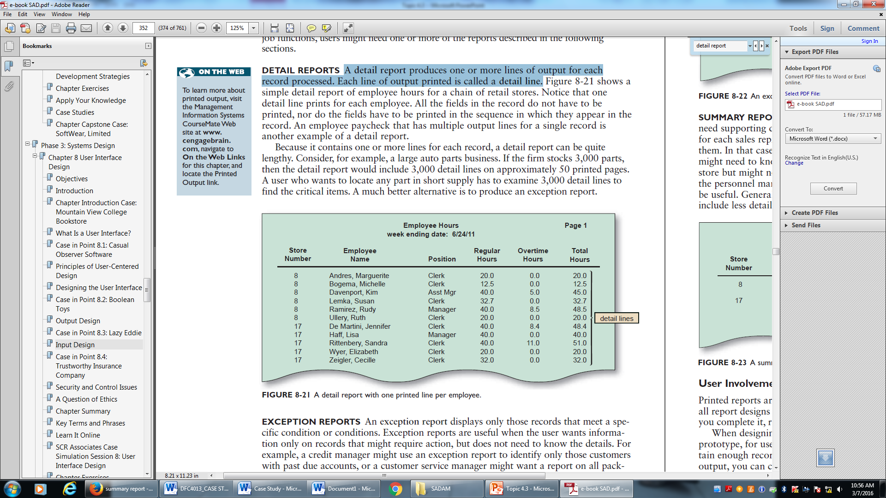
1. Detail Report
A detail report produces one or more lines of output for each record processed.
Each line of output printed is called a detail line.

Slide 35
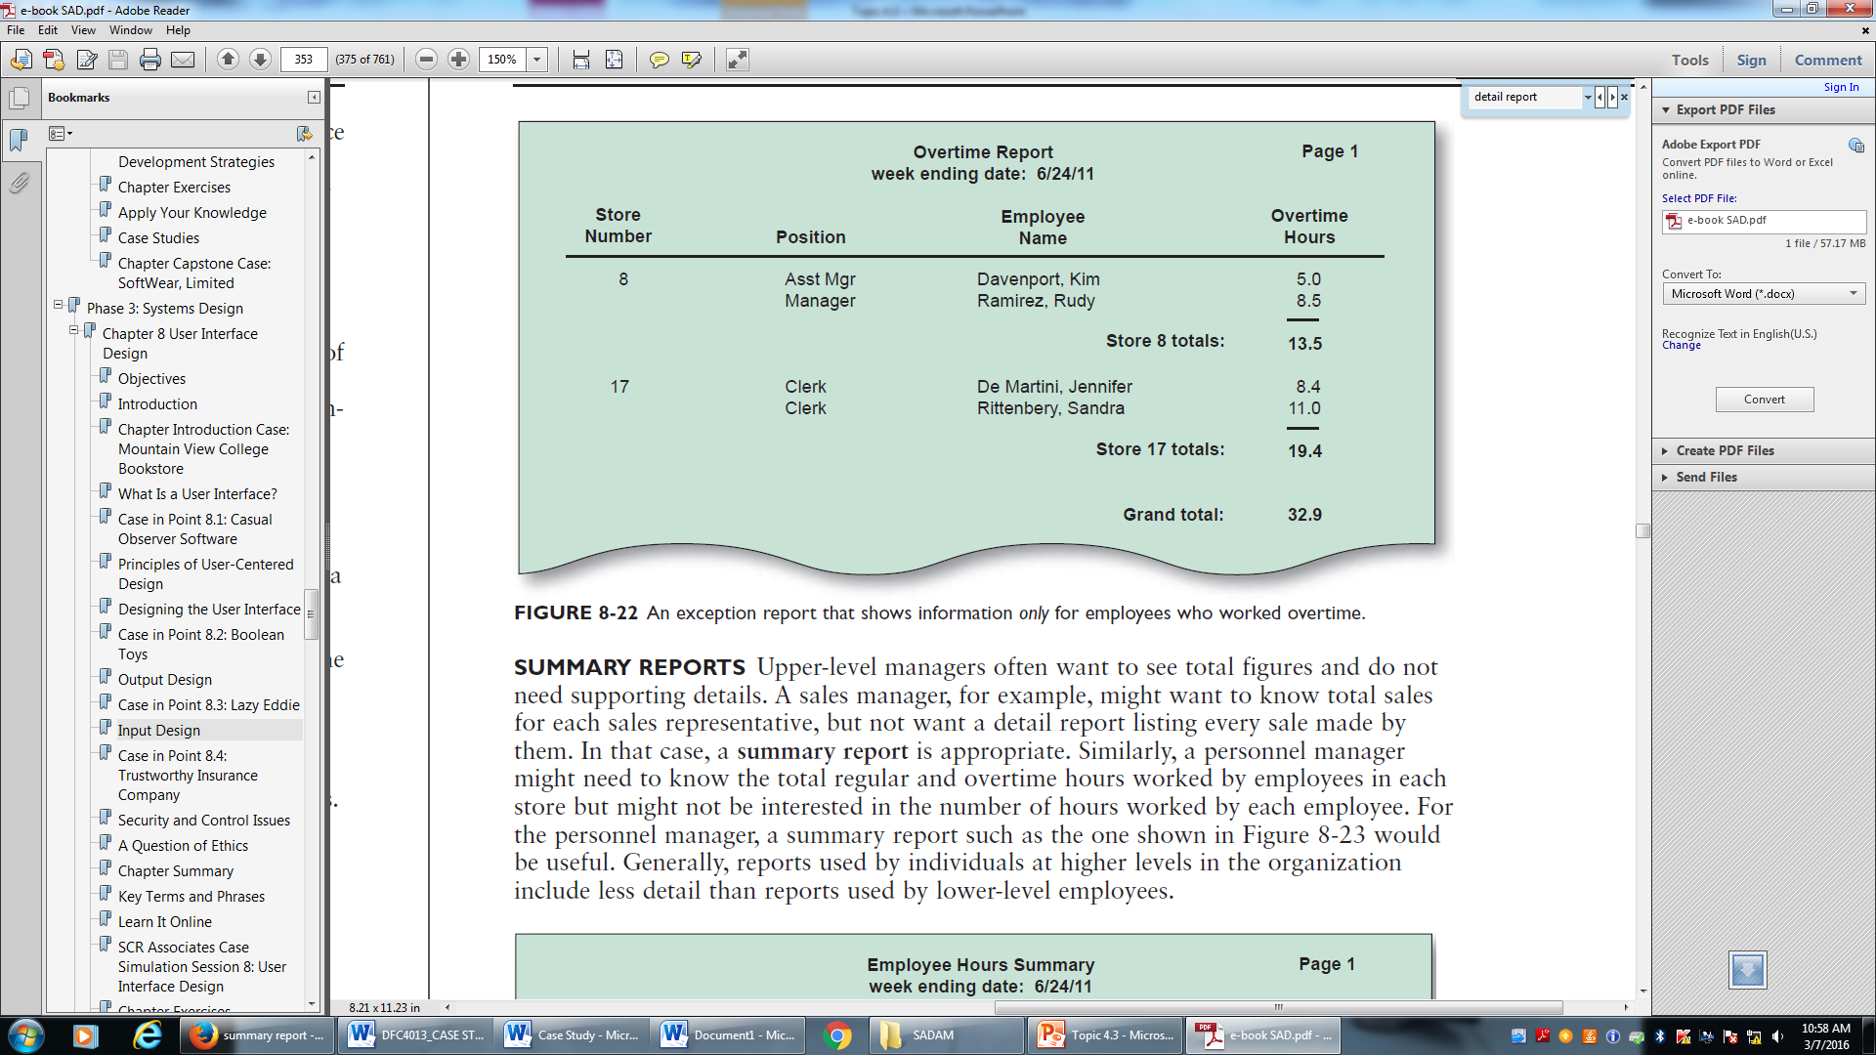
2. Exception Report
An exception report displays only those records that meet a specific condition or conditions.
Exception reports are useful when the user wants information only on records that might require action, but does not need to know the details.

Slide 36
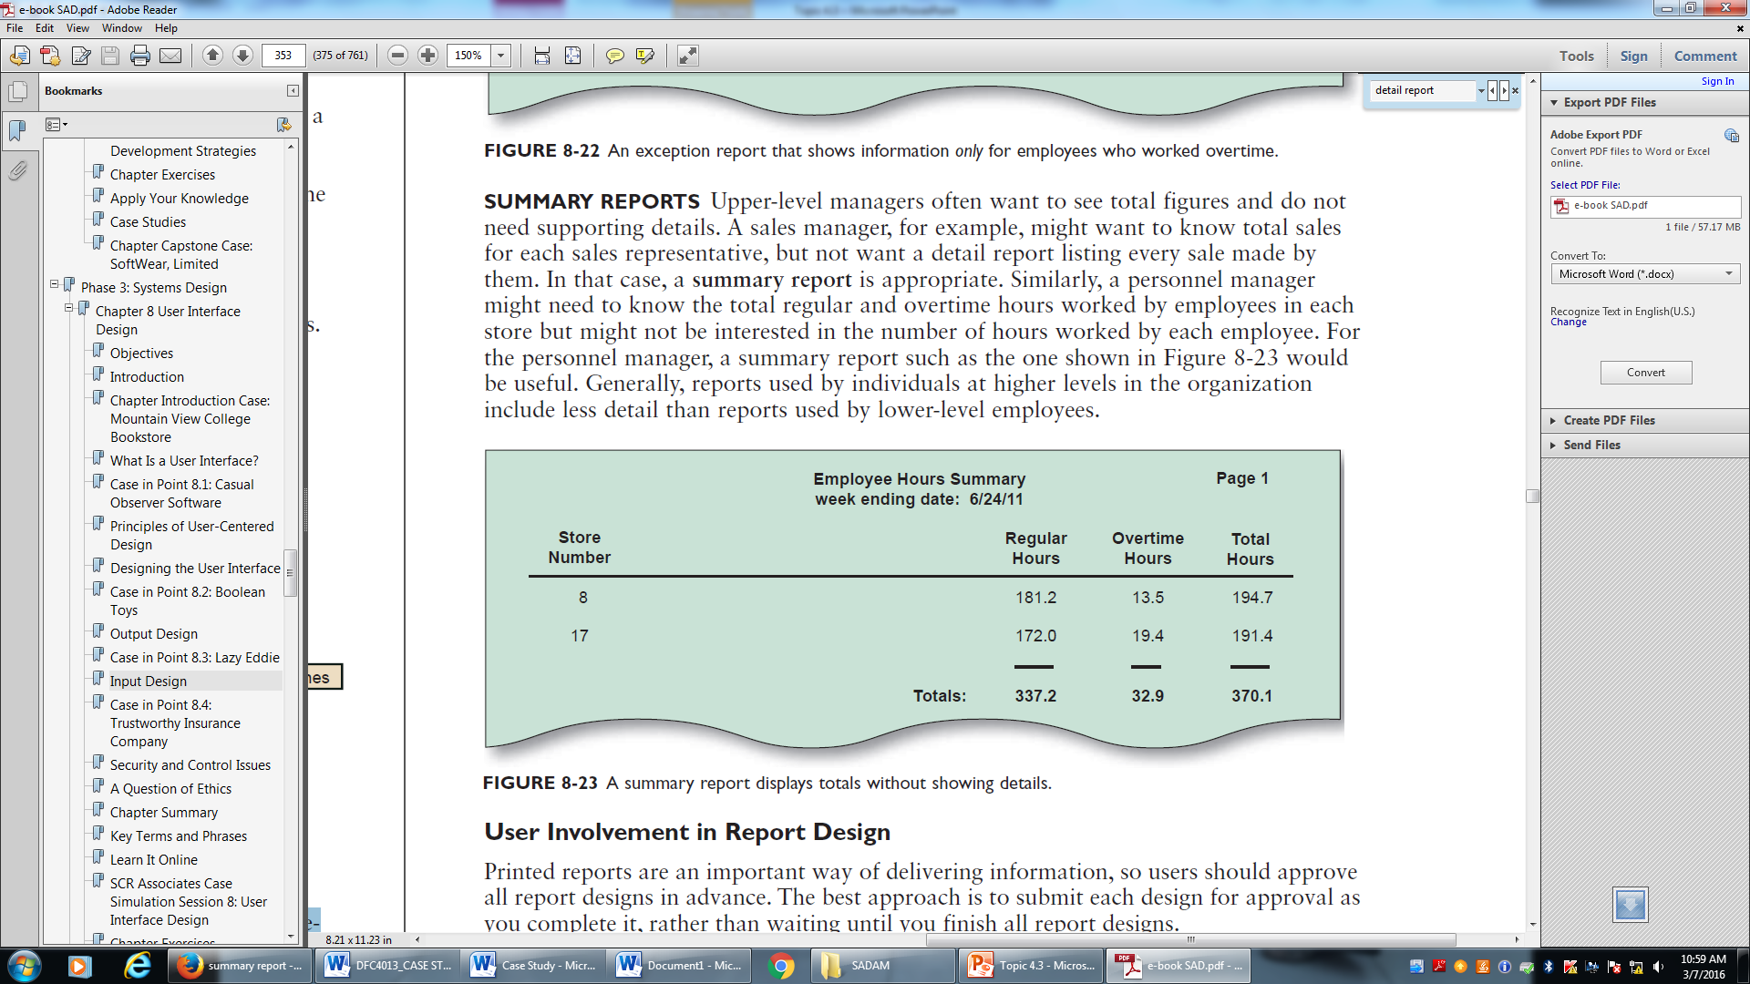
3. Summary Report
Upper-level managers often want to see total figures and do not need supporting details.
A sales manager, for example, might want to know total sales for each sales representative, but not want a detail report listing every sale made by them. In that case, a summary report is appropriate.

Slide 37
10. Report Design
When designing a report, you should prepare a sample report, called a mock-up, or prototype, for users to review.
The sample should include typical field values and contain enough records to show all the design features. Depending on the type of printed output, you can create a Word document or use a report generator to create mock-up reports.
After a report design is approved, you should document the design by creating a report analysis form, which contains information about the layout, fields, frequency, distribution, data security considerations, and other issues.

Slide 38
10. Report Design Principles
Printed reports must be attractive, professional, and easy to read. For example, a well-designed detail report should provide totals for numeric fields.
Good report design requires effort and attention to detail.
To produce a well designed report, the analyst must consider design features such as report headers and footers, page headers and footers, column headings and alignment, column spacing, field order, and grouping of detail lines.

Slide 39
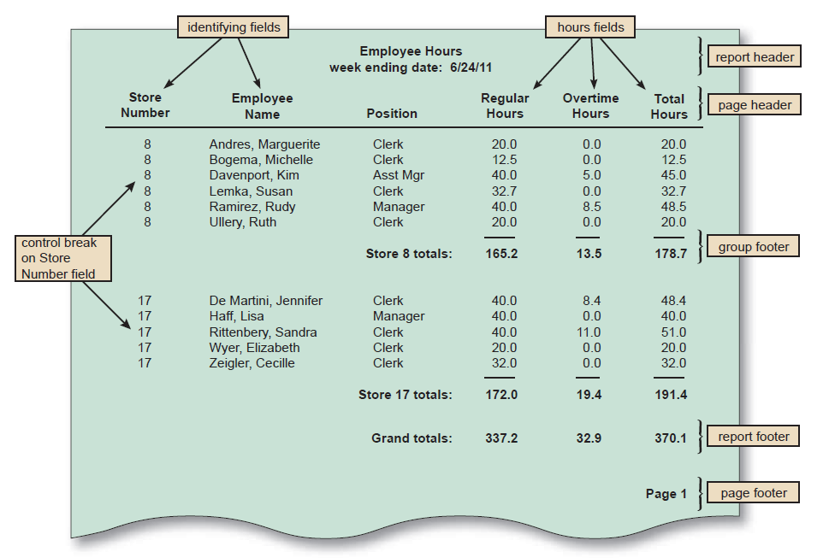
10. Report Design Principles
1. REPORT HEADERS AND FOOTERS
Every report should have a report header and a report footer.
The report header, which appears at the beginning of the report, identifies the report, and contains the report title, date, and other necessary information.
The report footer, which appears at the end of the report, can include grand totals for numeric fields and other end-of-report information

Slide 40
10. Report Design Principles
2. PAGE HEADERS AND FOOTERS
Every page should include a page header, which appears at the top of the page and includes the column headings that identify the data.
The headings should be short but descriptive. Avoid abbreviations unless you know that users will understand them clearly.
Either a page header or a page footer, which appears at the bottom of the page, is used to display the report title and the page number.

Slide 41
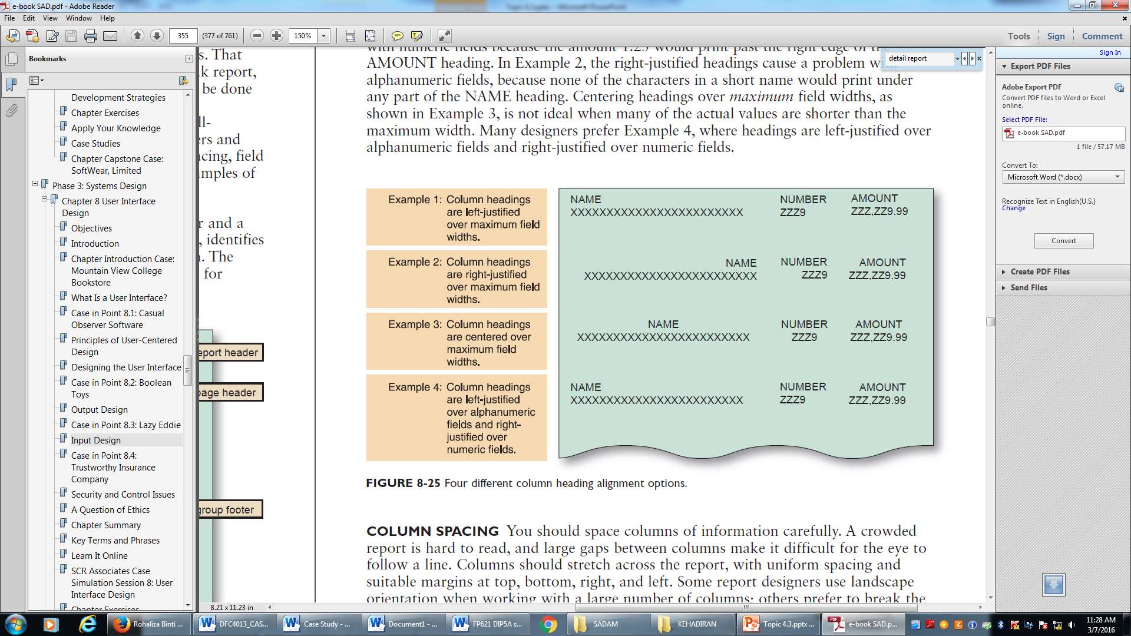
10. Report Design Principles
3. COLUMN HEADING ALIGNMENT
Many designers prefer Example 4, where headings are left-justified over
alphanumeric fields and right-justified over numeric fields.

Slide 42
10. Report Design Principles
4. COLUMN SPACING
A crowded report is hard to read, and large gaps between columns make it difficult for the eye to follow a line.
Columns should stretch across the report, with uniform spacing and suitable margins at top, bottom, right, and left.

Slide 43
10. Report Design Principles
5. FIELD ORDER
Fields should be displayed and grouped in a logical order.
Diagram below shows the detail lines printed in alphabetical order within store number, so the store number is in the left column, followed by the employee name.
The employee position relates to the employee’s name, so the items are adjacent. The three hours fields also are placed together.

Slide 44
10. Report Design Principles
6. GROUPING DETAIL LINES
It is meaningful to arrange detail lines in groups, based on a control field.
For example, using the department number as a control field, individual employees can be grouped by department. You can print a group header above the first detail line and a group footer after the last detail line in a group.

Slide 45
10. Report Design Principles
7. REPEATING FIELDS

Slide 46
10. Report Design Principles
7. CONSISTENT DESIGN
Reports should be uniform and consistent.
When a system produces multiple reports, each report should share common design elements.
For example, the date and page numbers should print in the same place on each report page.

Slide 47
11. Output Security & Control
Output must be accurate, complete, current, and secure.
Companies use various output control methods to maintain output integrity and security.
Output security protects privacy rights and shields the organization’s proprietary data from theft or unauthorized access.

Slide 48
11. Output Security & Control
To ensure output security, you must perform several important tasks.
First, limit the number of printed copies and use a tracking procedure to account for each copy.
When printed output is distributed from a central location, you should use specific procedures to ensure that the output is delivered to authorized recipients only.
That is especially true when reports contain sensitive information, such as payroll data.
All sensitive reports should be stored in secure areas.
All pages of confidential reports should be labeled appropriately.

Slide 49
11. Input Security & Control
Every piece of information should be traceable back to the input data that produced it.
That means that you must provide an audit trail that records the source of each data item and when it entered the system.
In addition to recording the original source, an audit trail must show how and when data is accessed or changed, and by whom.
All those actions must be logged in an audit trail file and monitored carefully.

Slide 50
11. Input Security & Control
A company must have procedures for handling source documents to ensure that data is not lost before it enters the system.
Data security policies and procedures protect data from loss or damage, which is a vital goal in every organization. If the safeguards are not 100% effective, data recovery utilities should be able to restore lost or damaged data.
Once data is entered, the company should store source documents in a safe location for some specified length of time.
The company should have a records retention policy that meets all legal requirements and business needs.

Slide 51
Summary
The chapter described various types of printed reports, including detail, exception, and summary reports.
You learned about the features and sections of reports, including control fields, control breaks, report headers and footers, page headers and footers, and group headers and footers.
You also learned about other types of output, such as Web based information delivery, instant messaging, e-mail, and other specialized forms of output.

Slide 52
Summary
The discussion of data entry screen design explained the use of input masks and validation rules to reduce data errors.
Input masks are like templates that only permit certain combinations of characters, and data validation rules can provide checks to ensure that inappropriate data is prevented from entering the system.
These checks can include data sequence, existence, range and limit, reasonableness, and validity, among others.

Slide 53
Summary
You also learned about batch and online input methods, input media and procedures, and input volume.
Input methods include data capture and data entry.
Data capture, which may be automated, involves identifying and recording source data.
Data entry involves converting source data into a computer-readable form and entering it into the system.
New technology offers optical and voice recognition systems, biological feedback devices, motion sensors, and a variety of graphical input devices.

Slide 54
Summary
Finally, you learned about security and control. Output control includes physical protection of data and reports, and control of unauthorized ports or devices that can extract data from the system.
Input controls include audit trails, encryption, password security, data security, and the creation of access levels to limit persons authorized to view or use data.

Slide 55
Exercise

